Slide 1
DTI5126
Fundamentals/Applied Data Science
Group Project:
Traffic volume in Minneapolis-Saint Paul westbound I-94
Group: 2

Slide 2
Table of contents
Introduction
Methodology
Problem Formulation
References
Testing
System Output
Future Work

Slide 3
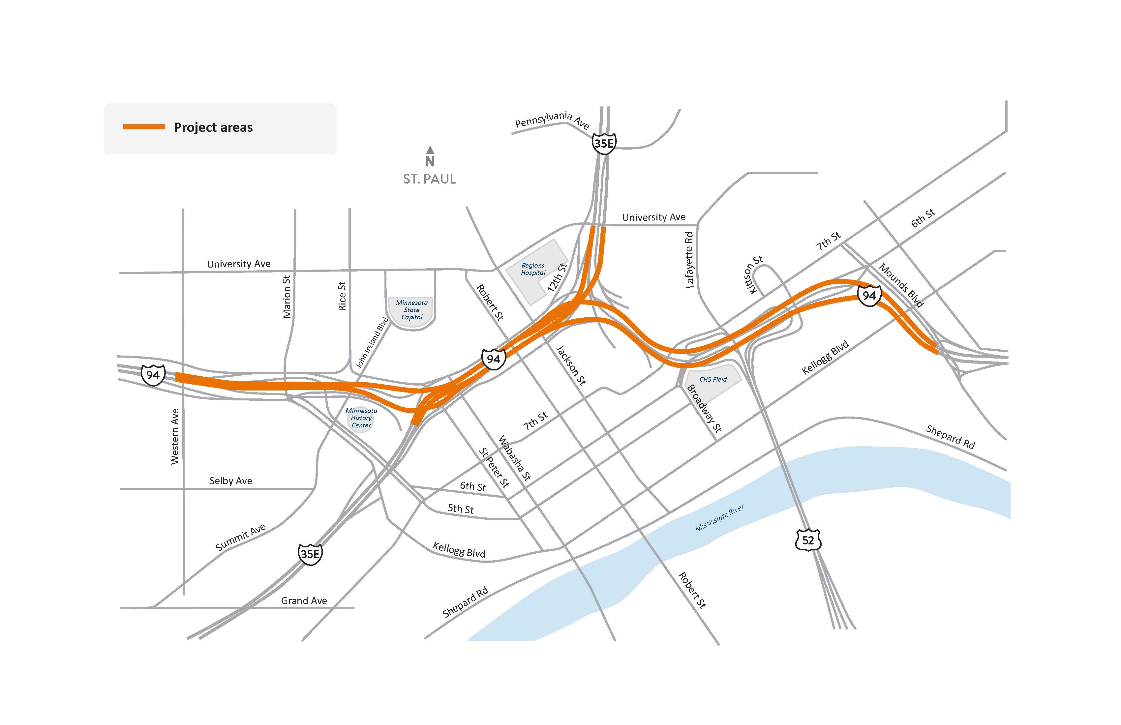
Problem Formulation
Minneapolis-Saint Paul westbound I-94 is one of the busiest highways in Minnesota.
Traffic congestions affect the society and individuals negatively throughout the year.
[4]
[4]

Slide 4
Problem Formulation (Affected themes)
Lanes’ expansion decisions including timing and duration.
Asphalt erosion repair and road maintenance scheduling.
Traffic lights capacity and durations.
Road services: patrol cars, towing trucks and others.
Ramp closures including exit roads, road tolls that might be constructed.

Slide 5
Introduction
The aim of this project is to predict traffic density in the highway for an upcoming time interval. As per reviewing previously done models for the same dataset, most of them tried to solve this problem using regression and time series using LSTM. In this project, forecasting traffic volume as a time series problem was initiated by also using regression and anomaly detection. An interactive web application was also made using a part of the project.

Slide 6
Methodology
Preprocessing
Anomaly Detection
Time Series
Prediction
Regression

Slide 7
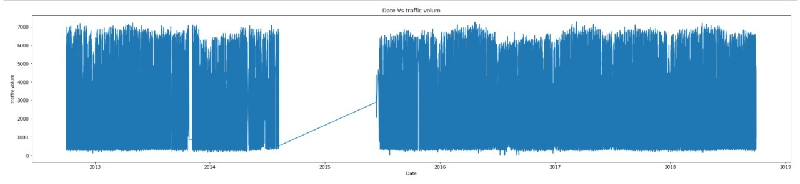
Methodology (Preprocessing)
Set the time interval from July 1st, 2018 to September 29th, 2018.
Set date time column as index of data frame.
Sorting the data frame in ascending order to deal with time series data later on.

Slide 8
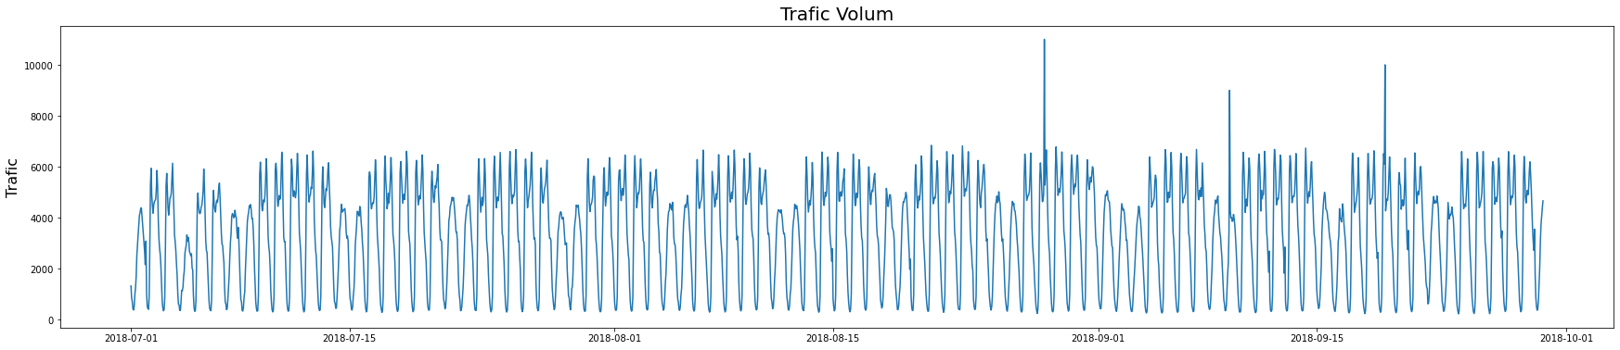
Methodology (Preprocessing)
The whole data:
Traffic Volume
Traffic

Slide 9
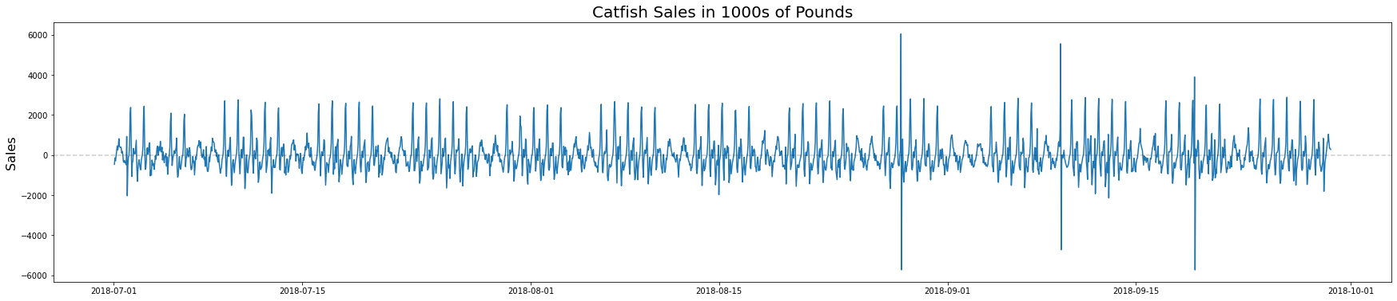
Methodology (Preprocessing)
Removing the trends:
Traffic Volume
Traffic

Slide 10
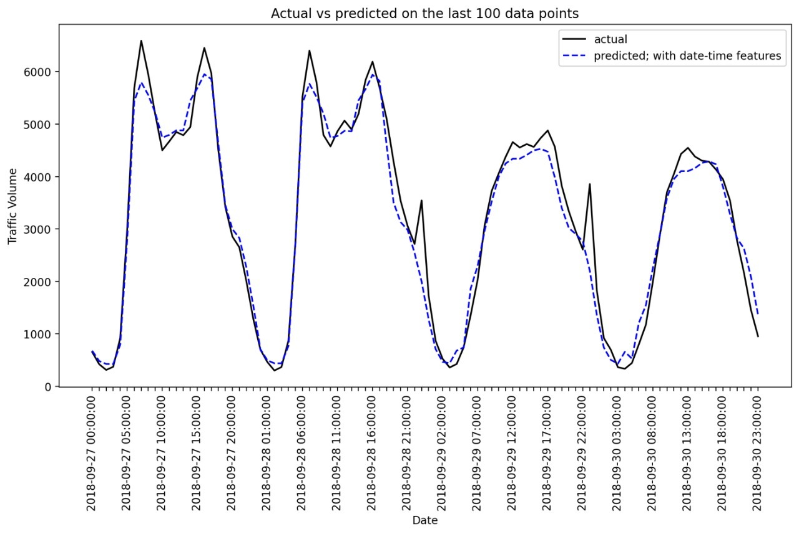
Methodology (Regression)
System Output:

Slide 11
Methodology (Anomaly Detection)
1. Deviation Method:
Get the window ending at specific data point.
Get the deviation within this window.
Get the difference in deviation between one time point and the next.

Slide 12
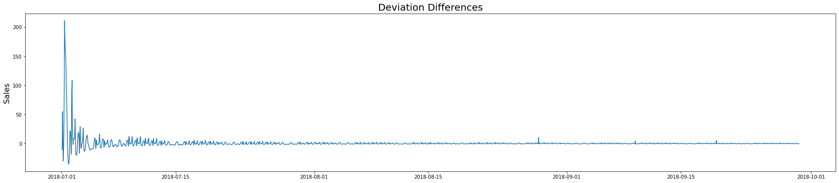
Methodology (Anomaly Detection)
1. Deviation Method:
Deviation differences for the chosen months:
Traffic

Slide 13
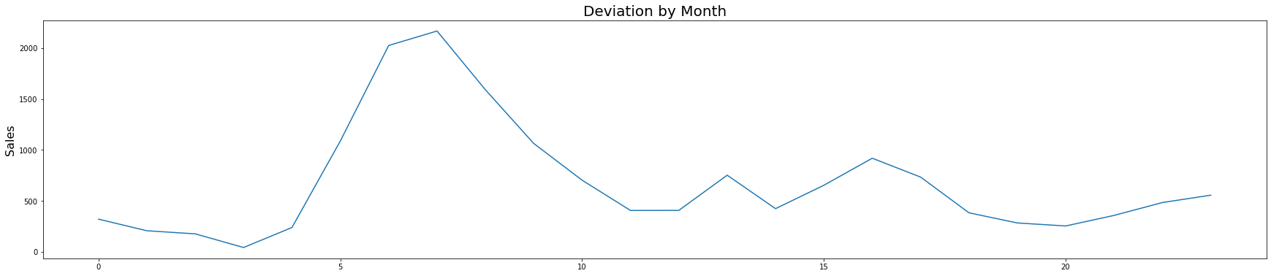
Methodology (Anomaly Detection)
2. Seasonal Method:
Show deviations by hour:
Deviations by Hour
Traffic

Slide 14
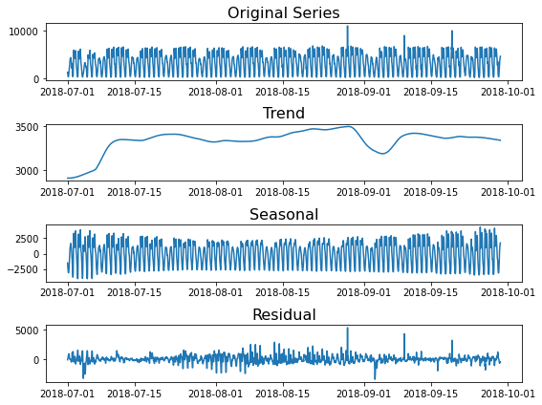
Methodology (Anomaly Detection)
3. Seasonal-Trend Decomposition using LOESS (STL):

Slide 15
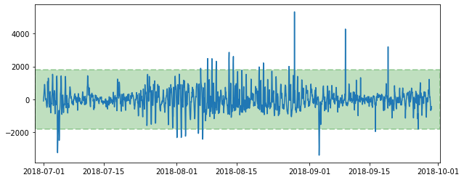
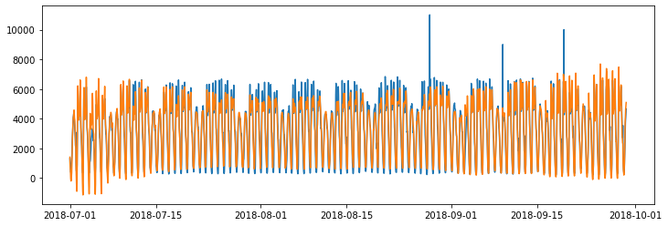
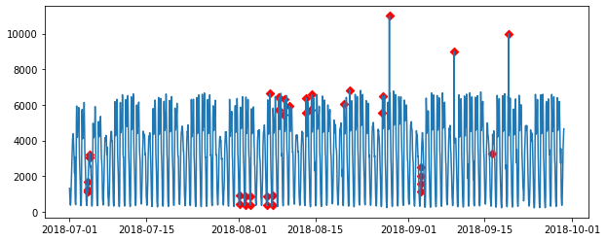
Methodology (Anomaly Detection)
3. Seasonal-Trend Decomposition using LOESS (STL):

Slide 16
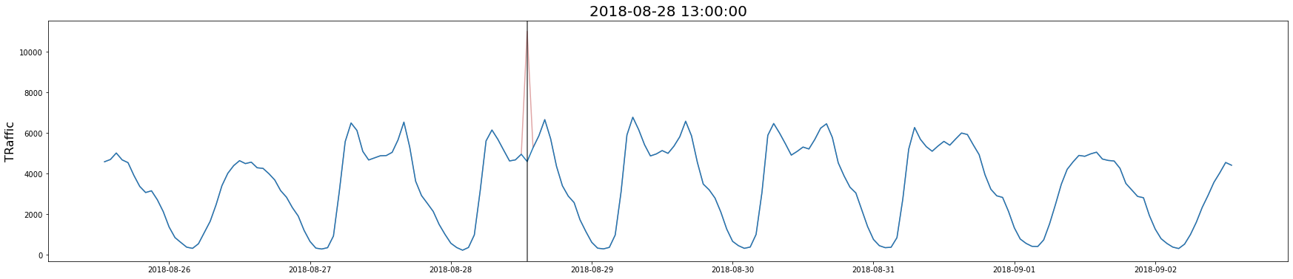
Methodology (Anomaly Detection)
Mean of other hours:

Slide 17
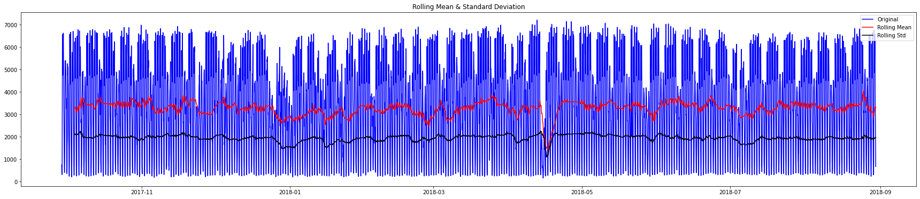
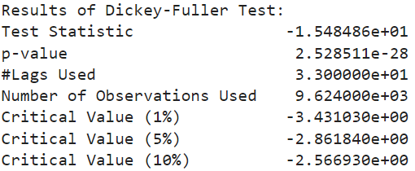
Methodology (Time Series)
Check if the data is stationary:

Slide 18
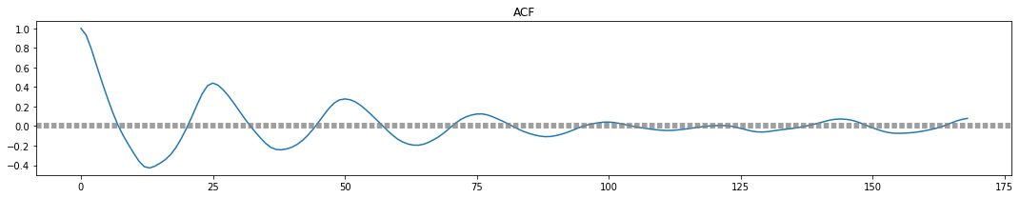
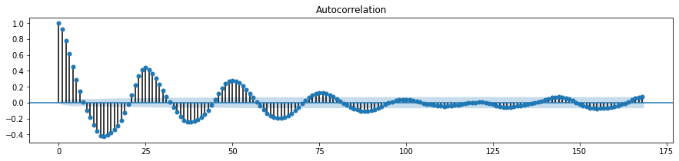
Methodology (Time Series)
Autocorrelation function:

Slide 19
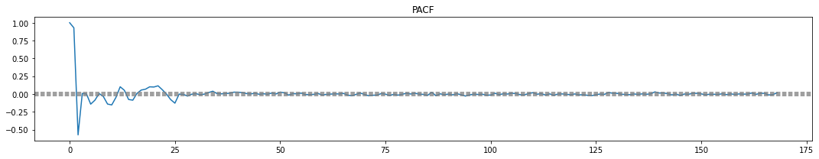
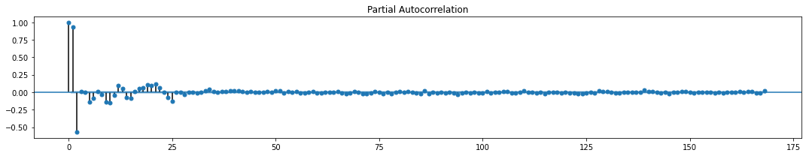
Methodology (Time Series)
Partial autocorrelation function:

Slide 20
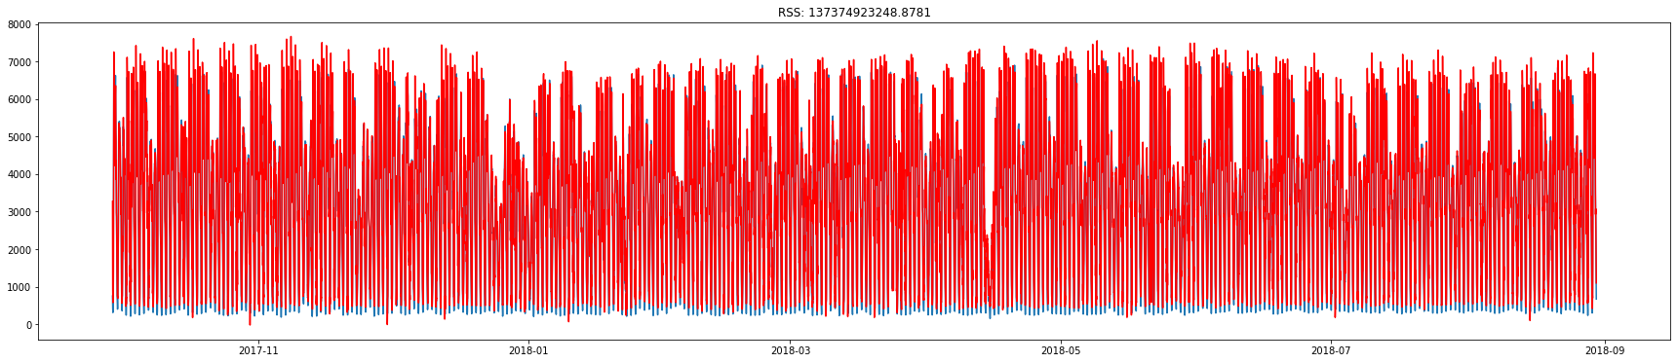
Methodology (Prediction)
Autoregressive integrated moving average (ARIMA):

Slide 21
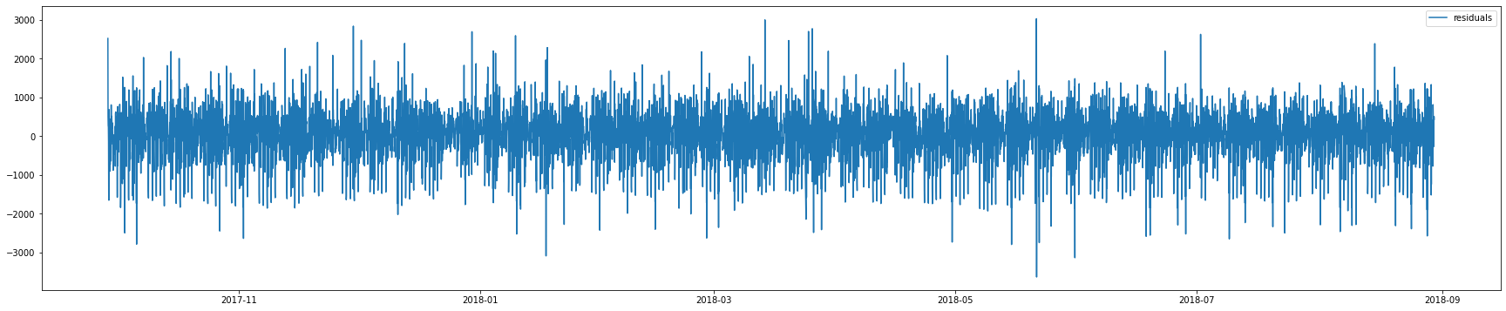
Methodology (Prediction)
Residuals Plot:

Slide 22
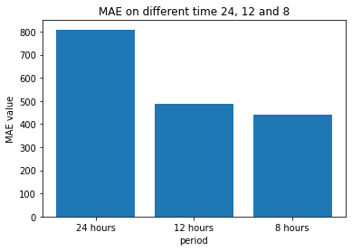
Methodology (Prediction)
Best Number of prediction hours:

Slide 23
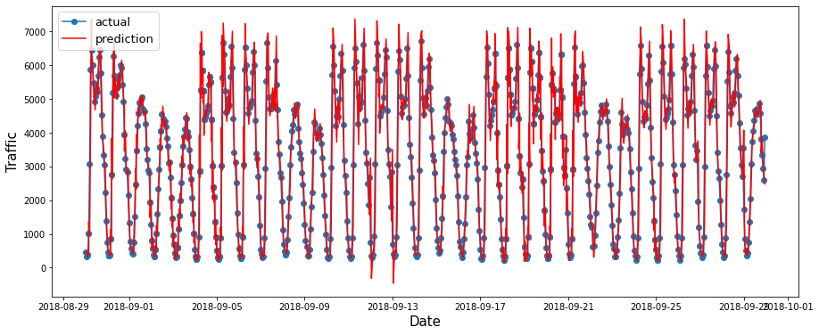
Testing
Test the ARIMA model on test dataset:
Mean Absolute error: 429.5161312457795
Root Mean Squared error: 644.0854091379808
Mean Absolute percentage Error: 19.07707269113014

Slide 24
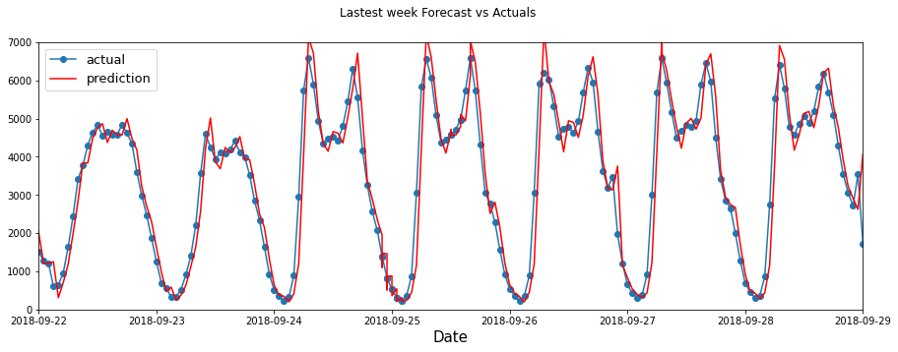
Testing
Test the ARIMA model on test dataset (One week):

Slide 25
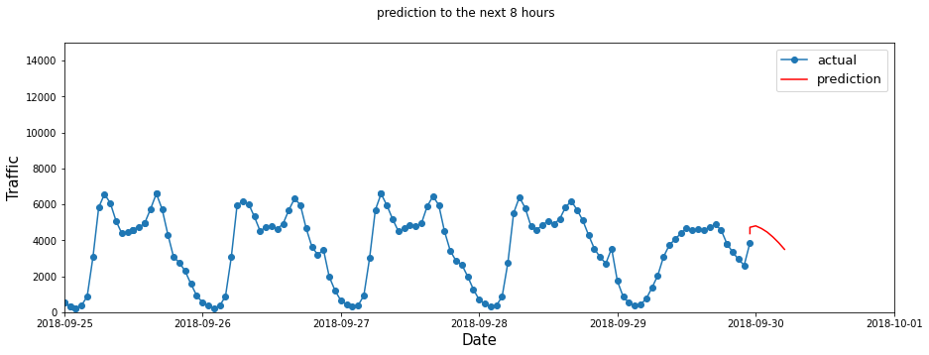
System Output
Forecasting for the next 8 hours:

Slide 26
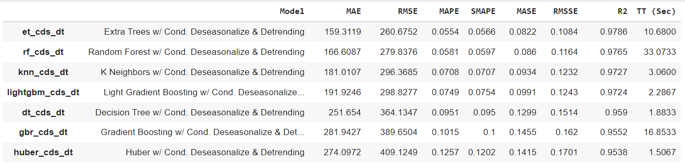
Future work
Comparison between other models:

Slide 27
References
[1] Chandel, Apurv. “An Accurate Estimation of Interstate Traffic of Metro City Using Linear Regression Model of Machine Learning.” Papers.ssrn.com, 11 May 2020, papers.ssrn.com/sol3/papers.cfm?abstract_id=3598310. Accessed 20 May 2022.
[2] Ermagun, Alireza, et al. “Using Temporal Detrending to Observe the Spatial Correlation of Traffic.” PLOS ONE, vol. 12, no. 5, 4 May 2017, p. e0176853, 10.1371/journal.pone.0176853. Accessed 17 July 2019.
[3] Hogue, John. “UCI Machine Learning Repository: Metro Interstate Traffic Volume Data Set.” Archive.ics.uci.edu, archive.ics.uci.edu/ml/datasets/Metro+Interstate+Traffic+Volume. (The used dataset)
[4] “I-94/I-35E in St. Paul Project - MnDOT.” Www.dot.state.mn.us, www.dot.state.mn.us/metro/projects/i94-i35e-stpaul/. Accessed 20 May 2022.
[5] Kanokwan Khiewwan, et al. “Application of Data Mining Techniques for Classification of Traffic Affecting Environments.” Journal of Renewable Energy and Smart Grid Technology, vol. 15, no. 1, 2020, ph01.tci-thaijo.org/index.php/RAST/article/view/240698. Accessed 20 May 2022.
[6] Mrs. B.Karthika, Et Al. “Traffic Flow Prediction Using an Improved Fuzzy Convolutional LSTM Algorithm.” Turkish Journal of Computer and Mathematics Education (TURCOMAT), vol. 12, no. 10, 28 Apr. 2021, pp. 5541–5549, turcomat.org/index.php/turkbilmat/article/view/5361, 10.17762/turcomat.v12i10.5361. Accessed 20 May 2022.
[7] Yin, Zexuan, and Paolo Barucca. “Stochastic Recurrent Neural Network for Multistep Time Series Forecasting.” Neural Information Processing, 2021, pp. 14–26, 10.1007/978-3-030-92185-9_2. Accessed 20 May 2022.
[8] Zhao, Jingyu, et al. Do RNN and LSTM Have Long Memory?

Slide 28
Thank You

